Slide 1
Chapter 10
And, Finally...
The Stack

Slide 2
Stack: An Abstract Data Type
An important abstraction that you will encounter
in many applications.
We will describe three uses:
Evaluating arithmetic expressions
  Store intermediate results on stack instead of in registers
Data type conversion
  2’s comp binary to ASCII strings

Slide 3
Stacks
A LIFO (last-in first-out) storage structure.
  The first thing you put in is the last thing you take out.
  The last thing you put in is the first thing you take out.
This means of access is what defines a stack,
not the specific implementation.
Two main operations:
PUSH: add an item to the stack
POP: remove an item from the stack

Slide 4
A Physical Stack
Coin rest in the arm of an automobile
First quarter out is the last quarter in.
1995
1996
1998
1998
1982
1982
1995
1995
Initial State
After
One Push
After Three
More Pushes
After
One Pop

Slide 5
A Hardware Implementation
Data items move between registers
Empty:
Yes
Empty:
No
Empty:
No
Empty:
No
/ / / / / /
TOP
#18
TOP
#12
TOP
#31
TOP
/ / / / / /
/ / / / / /
#5
#18
/ / / / / /
/ / / / / /
#31
/ / / / / /
/ / / / / /
/ / / / / /
#18
/ / / / / /
/ / / / / /
/ / / / / /
/ / / / / /
/ / / / / /
Initial State
After
One Push
After Three
More Pushes
After
Two Pops

Slide 6
A Software Implementation
Data items don't move in memory,
just our idea about there the TOP of the stack is.
/ / / / / /
/ / / / / /
#12
TOP
#12
/ / / / / /
/ / / / / /
#5
#5
/ / / / / /
/ / / / / /
#31
#31
TOP
/ / / / / /
#18
TOP
#18
#18
/ / / / / /
TOP
/ / / / / /
/ / / / / /
/ / / / / /
x4000
R6
x3FFF
R6
x3FFC
R6
x3FFE
R6
Initial State
After
One Push
After Three
More Pushes
After
Two Pops
By convention, R6 holds the Top of Stack (TOS) pointer.

Slide 7
Basic Push and Pop Code
For our implementation, stack grows downward
(when item added, TOS moves closer to 0)
Push
ADD R6, R6, #-1 ; decrement stack ptr
STR R0, R6, #0 ; store data (R0)
Pop
LDR R0, R6, #0 ; load data from TOS
ADD R6, R6, #1 ; decrement stack ptr

Slide 8
Pop with Underflow Detection
If we try to pop too many items off the stack,
an underflow condition occurs.
  Check for underflow by checking TOS before removing data.
  Return status code in R5 (0 for success, 1 for underflow)
POP LD R1, EMPTY ; EMPTY = -x4000
ADD R2, R6, R1 ; Compare stack pointer
BRz FAIL ; with x3FFF
LDR R0, R6, #0
ADD R6, R6, #1
AND R5, R5, #0 ; SUCCESS: R5 = 0
RET
FAIL AND R5, R5, #0 ; FAIL: R5 = 1
ADD R5, R5, #1
RET
EMPTY .FILL xC000

Slide 9
Push with Overflow Detection
If we try to push too many items onto the stack,
an overflow condition occurs.
  Check for underflow by checking TOS before adding data.
  Return status code in R5 (0 for success, 1 for overflow)
PUSH LD R1, MAX ; MAX = -x3FFB
ADD R2, R6, R1 ; Compare stack pointer
BRz FAIL ; with x3FFF
ADD R6, R6, #-1
STR R0, R6, #0
AND R5, R5, #0 ; SUCCESS: R5 = 0
RET
FAIL AND R5, R5, #0 ; FAIL: R5 = 1
ADD R5, R5, #1
RET
MAX .FILL xC005

Slide 10
Arithmetic Using a Stack
Instead of registers, some ISA's use a stack for
source and destination operations: a zero-address machine.
  Example:
  ADD instruction pops two numbers from the stack,
  adds them, and pushes the result to the stack.
Evaluating (A+B)·(C+D) using a stack:
(1) push A
(2) push B
(3) ADD
(4) push C
(5) push D
(6) ADD
(7) MULTIPLY
(8) pop result
Why use a stack?
  Limited registers.
  Convenient calling convention for subroutines.
  Algorithm naturally expressed using FIFO data structure.

Slide 11
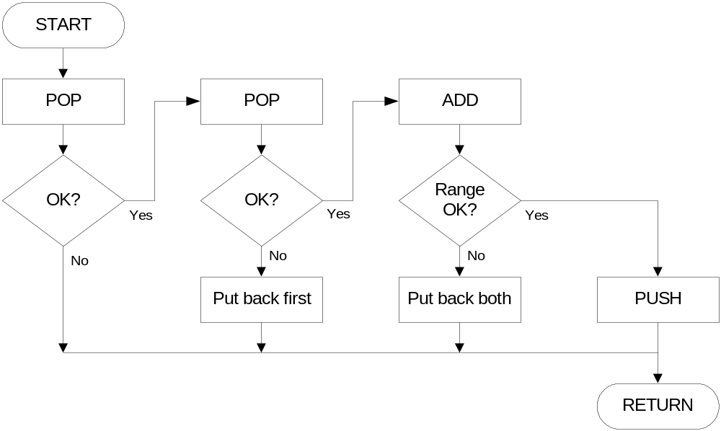
Example: OpAdd
POP two values, ADD, then PUSH result.

Slide 12
Example: OpAdd
OpAdd JSR POP ; Get first operand.
ADD R5,R5,#0 ; Check for POP success.
BRp Exit ; If error, bail.
ADD R1,R0,#0 ; Make room for second.
JSR POP ; Get second operand.
ADD R5,R5,#0 ; Check for POP success.
BRp Restore1 ; If err, restore & bail.
ADD R0,R0,R1 ; Compute sum.
JSR RangeCheck ; Check size.
BRp Restore2 ; If err, restore & bail.
JSR PUSH ; Push sum onto stack.
RET
Restore2 ADD R6,R6,#-1 ; Decr stack ptr (undo POP)
Restore1 ADD R6,R6,#-1 ; Decr stack ptr
Exit RET

Slide 13
Data Type Conversion
Keyboard input routines read ASCII characters,
not binary values.
Similarly, output routines write ASCII.
Consider this program:
TRAP x23 ; input from keybd
ADD R1, R0, #0 ; move to R1
TRAP x23 ; input from keybd
ADD R0, R1, R0 ; add two inputs
TRAP x21 ; display result
TRAP x25 ; HALT
User inputs 2 and 3 -- what happens?
Result displayed: e
Why? ASCII '2' (x32) + ASCII '3' (x33) = ASCII 'e' (x65)

Slide 14
ASCII to Binary
Useful to deal with mult-digit decimal numbers
Assume we've read three ASCII digits (e.g., "259")
into a memory buffer.
How do we convert this to a number
we can use?
  Convert first character to digit (subtract x30)
  and multiply by 100.
  Convert second character to digit and
  multiply by 10.
  Convert third character to digit.
  Add the three digits together.
x32
'2'
x35
'5'
x39
'9'

